Slide 1



SVD-BASED NOISE REDUCTION IN EEG SIGNALS
A Linear Algebra Approach to
Biomedical Signal Enhancement
Presented by: Manohar P, Mrudula, Sainath, Pushpak (Team - 9)

Slide 2
Intro
Problem Statement
The Objective: Extract weak Electroencephalogram (EEG) signals hidden within strong Electrooculogram (EOG/eye movement) artefacts.
The Challenge: EOG signals are in the millivolt range, while EEG signals are in the microvolt range. The "noise" (EOG) is energetically stronger than the "signal" (EEG).
The Hypothesis: EEG and EOG signals are uncorrelated and orthogonal to each other. This geometric property allows for separation using linear basis transformations.

Slide 3




Matrix Formulation of the Data
Data Construction: We construct a data matrix , where:
P = Number of observed channels (electrodes), q = Number of time samples recorded.
The Linear Model: The observed signal is modelled as a linear combination of source signals and noise:
M =TS + N
: Mixing matrix (weighting coefficients).
: Source signals (EOG artifacts), : The desired "noise" signals (Pure EEG).
r : Rank of the artifact source (number of independent EOG sources).

Slide 4

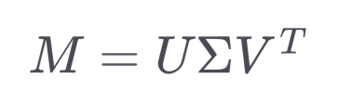



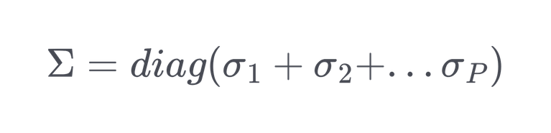
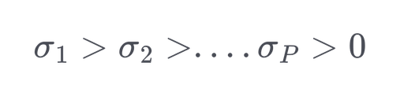


Singular Value Decomposition (SVD) - The Tool
Definition: Any real matrix (where P < q) can be decomposed into:
Components:
: Left singular vectors (Orthonormal basis for the electrode space).
: Right singular vectors (Orthonormal basis for the time space).
: Diagonal matrix of singular values.
Mathematical Significance: The singular values represent the energy or information content along the direction of the corresponding singular vectors

Slide 5
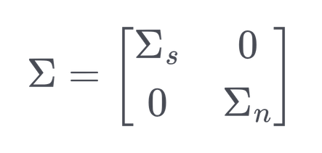


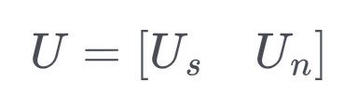


Subspace Decomposition
Partitioning the Space: The matrix is split into two orthogonal subspaces based on
energy (singular values):
(Signal Subspace): Contains the largest r singular values. Since EOG artefacts have high amplitude (millivolts), they dominate this subspace.
(Noise Subspace): Contains the remaining P-r singular values. The weaker EEG signals (microvolts) reside here.
Basis Vector Partitioning: The unitary matrix U is similarly partitioned:
: Spans the EOG artefact subspace.
: Spans the clean EEG subspace.

Slide 6
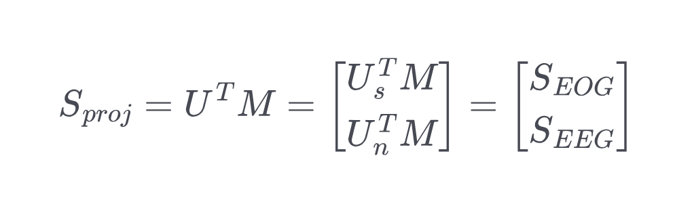

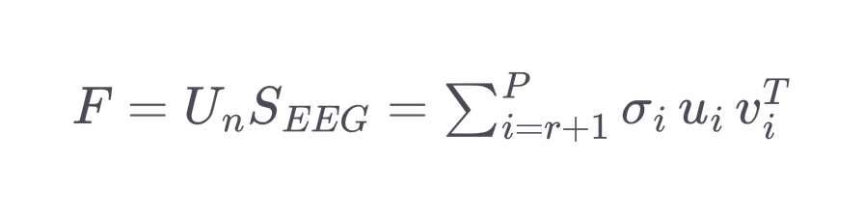
The Separation Algorithm
Projection: We project the data matrix M onto the new orthonormal basis
The top rows (SEOG) capture the high-energy artefacts.
The bottom rows (SEEG) capture the desired brain signals.
Reconstruction (The Solution): To recover the clean EEG (F), we reconstruct the matrix using only the subspace components corresponding to the EEG (from index r + 1 to P):
This effectively filters out the rank-r artefact component from the data.

Slide 7


Rank Estimation & Orthogonality
Why this works: The method relies on the Orthogonality Condition: EEG EOG. If
they were correlated, the subspaces would mix, and SVD would fail to separate them cleanly.
Rank Selection (r): In the study, singular values were grouped. The highest singular value ( ) corresponded to the EOG (r = 1) because EOG power > EEG power.
Typically, the effective number of linearly independent EOG signals is 1 (r = 1) due to the high correlation between left and right eye movements.

Slide 8
Results & Quantitative Analysis According to the Paper
Signal-to-Noise Ratio (SNR):
Input SNR (Contaminated): 9.5 dB.
Output SNR (SVD Processed): ~10.07 dB.
Spectral Analysis (Linear Prediction):
Before SVD: The spectrum showed large low-frequency peaks (characteristic of eye
movements).
After SVD: The low-frequency artefact peaks were removed, matching the spectrum of the pure desired EEG.
Conclusion: The SVD technique successfully utilizes the energy difference and
orthogonality to separate signal subspaces without needing complex filtering.

Slide 9
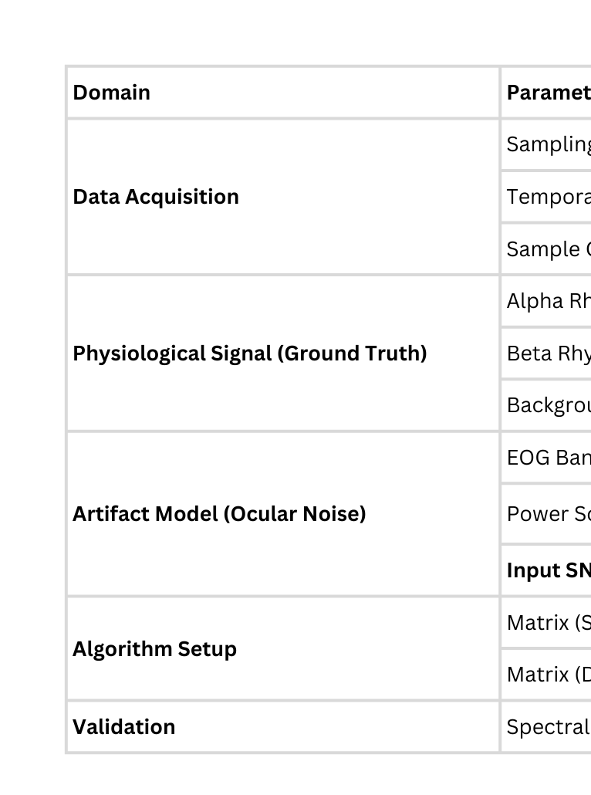
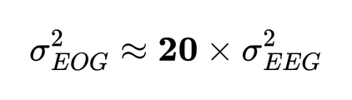


Experimental Inputs & Simulation Conditions

Slide 10
Time-Domain Reconstruction
•⁠ ⁠Input Signal Quality: The simulation imposed a harsh artifact-dominant environment with an Input SNR of -9.50 dB.
•⁠ ⁠Reconstruction Fidelity:
•⁠ ⁠Single Reference (): Achieved an Output SNR of 13.83 dB.
•⁠ ⁠Dual Reference (): Achieved an Output SNR of 19.16 dB.

Slide 11
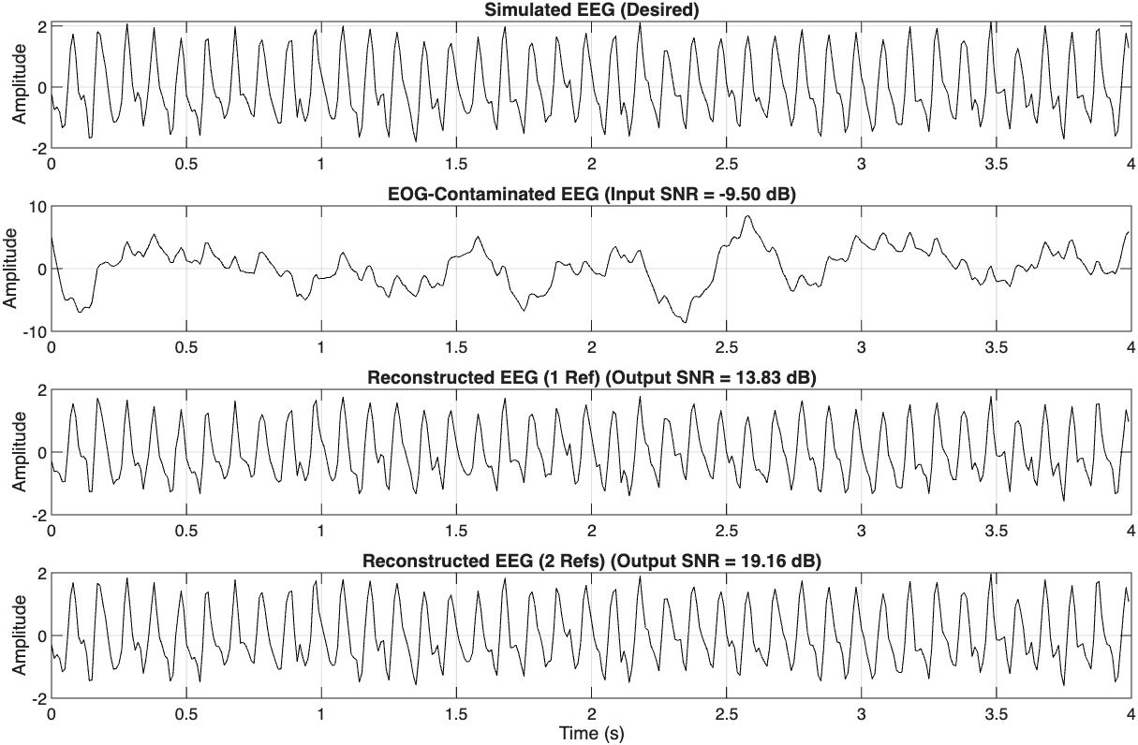
Time-Domain Reconstruction

Slide 12
Spectral Analysis & Validation
Frequency-Domain Observations
•⁠ ⁠Artefact Elimination: The power spectral density (PSD) of the contaminated signal (dashed line) displays a dominant high-energy peak in the 0–5 Hz band, corresponding to the ocular artefact components. The SVD-processed output (dotted line) shows complete suppression of this spectral noise.
•⁠ ⁠Physiological Preservation: Crucially, the spectral peaks corresponding to the Alpha (10 Hz) and Beta (20 Hz) neural bands are preserved with high fidelity.
Methodological Validation
•⁠ ⁠Spectral Selectivity: The results confirm that the algorithm achieves precise spectral separation based on signal covariance rather than hard frequency cutoffs.
•⁠ ⁠Signal Integrity: The overlap between the reconstructed signal spectrum and the ground truth (solid line) confirms that the subspace projection preserves the phase and amplitude of the neurological components while selectively filtering the artifact subspace.

Slide 13
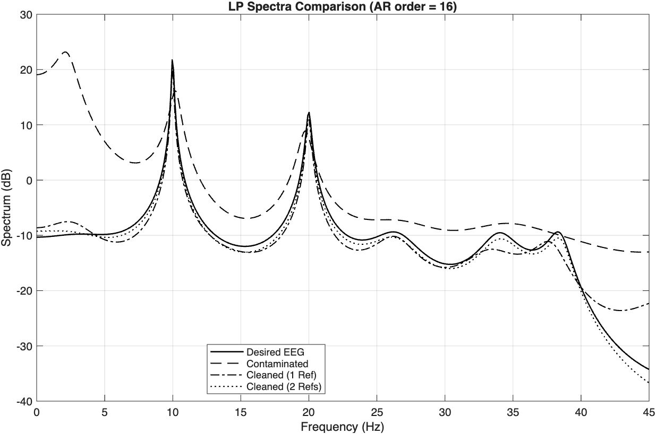
Spectral Characterization

Slide 14
THANK YOU

